Slide 1

Notes:
1

Slide 2
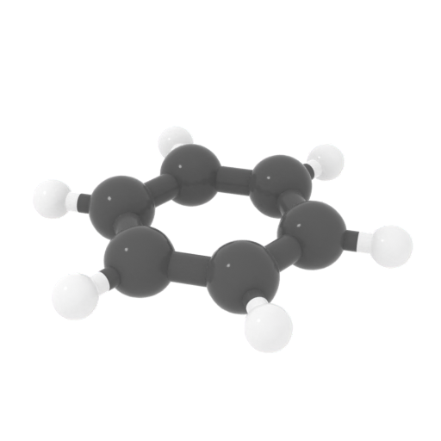
Notes:
2. Benzene fades in and rotates around the z-axis

Slide 3
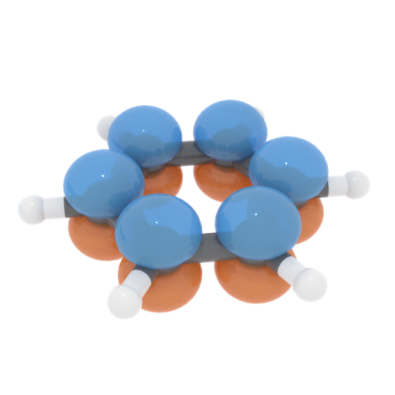
Notes:
3. While rotating the molecule, put the orbitals in by scaling them from within each carbon atom

Slide 4
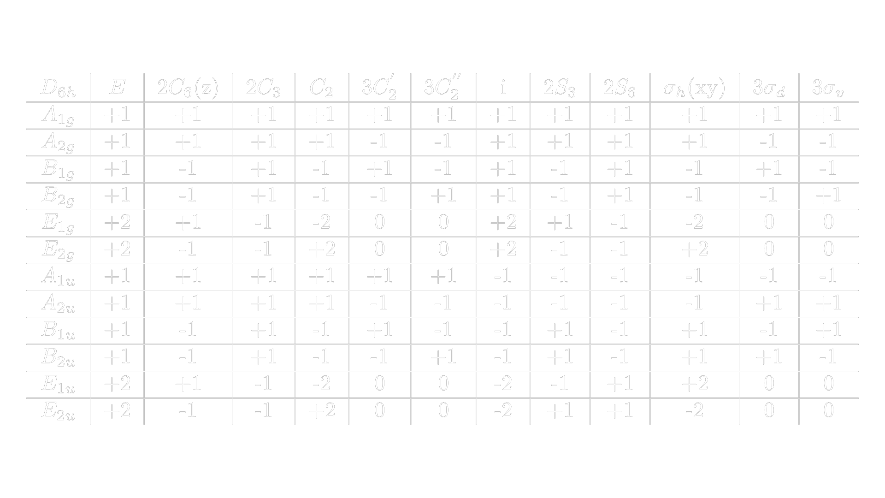
Notes:
4. While rotating the molecule, scale it down and move it to the side while playing the write animation of the table.

Slide 5
Notes:
4. When mentioning symmetry operations, highlight them on the point group table. This highlight does not have to go on top of the rest. Instead, everything EXCEPT the row where we want the focus can have its alpha decreased

Slide 6
Notes:
5.Write in the trace.

Slide 7
Notes:
6. Still rotating the molecule, fade everything except the irreps and the trace

Slide 8
Notes:
“But first, some rules.”
7. Move the benzene molecule to the center of the screen while “unfading” and everything else fades out.

Slide 9
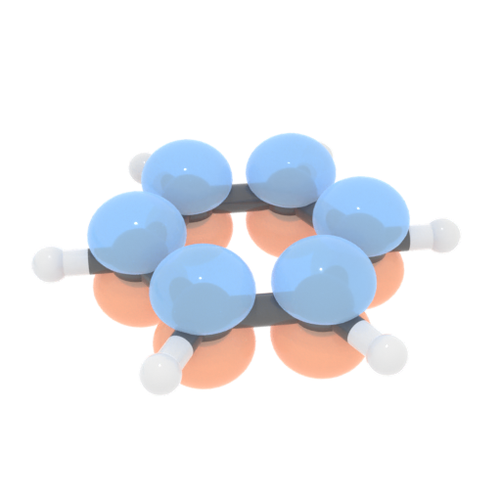
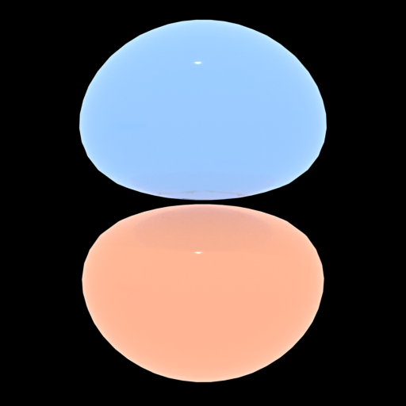
Notes:
8. We show the glowing as indication of atoms staying in place.

Slide 10
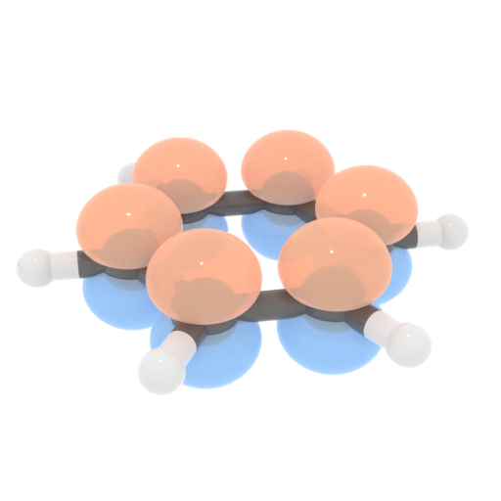

Notes:
10. We reflect the orbital across the z-axis and make them glow.

Slide 11
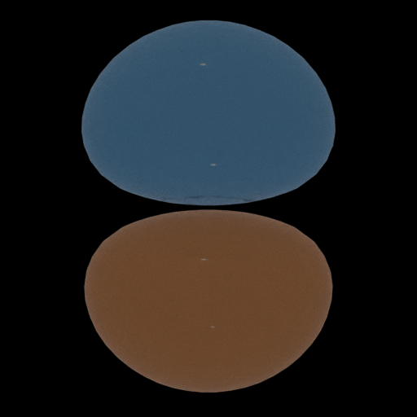

Notes:
10. We make the orbitals that leave their original position invisible.
Use fade out animation on the orbitals.

Slide 12
Notes:
10. Fade everything out. For a very short pause

Slide 13
Notes:
11. Write animation of the symmetry operations

Slide 14
Notes:
12. Underline fades in under E and molecule and the atomic orbitals get scaled up back to the surface.

Slide 15
Notes:
12. Underline fades in under E and molecule and the atomic orbitals get scaled up back to the surface.

Slide 16

Notes:
12. All the numbers migrate up and form the 6.

Slide 17

Notes:
12. All the numbers migrate up and form the 6.

Slide 18
Notes:
13. Fade out the molecule and the header. Move the numbers to the vector.

Slide 19
Notes:
14. Talk

Slide 20
Notes:
15. Fade in the table and highlight A1g

Slide 21

Notes:
15. Animate the dot product divided by 12.

Slide 22



Notes:
16. Show the other results for reference.

Slide 23
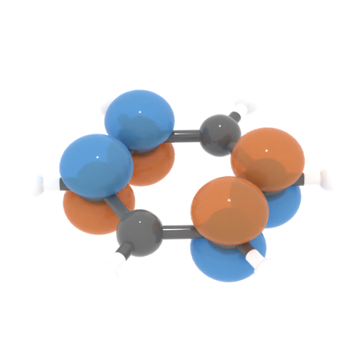
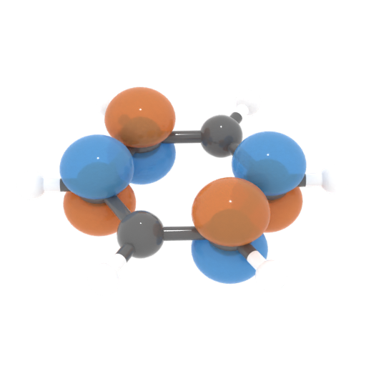
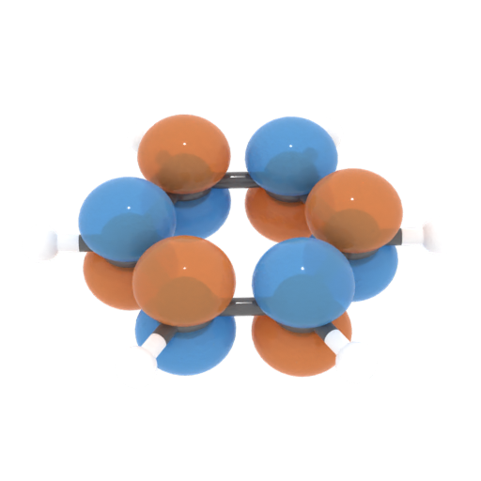
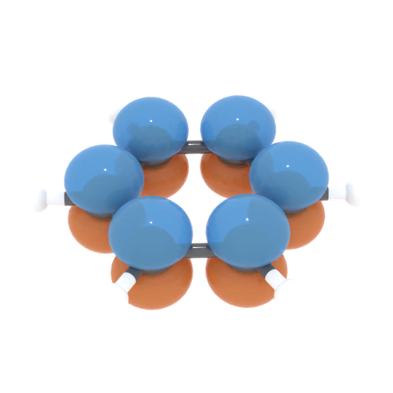
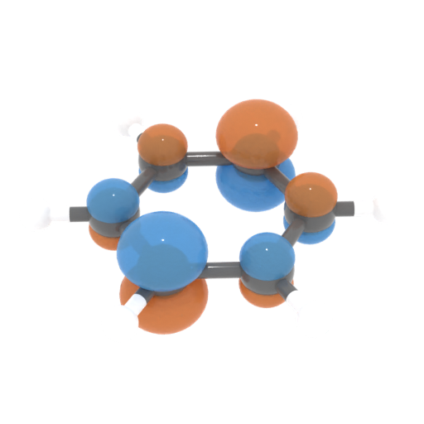
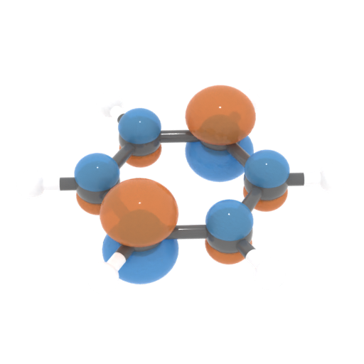
Notes:
Tease them into watching more clips by showing the molecular orbitals that can be generated from these irreps.

Slide 24
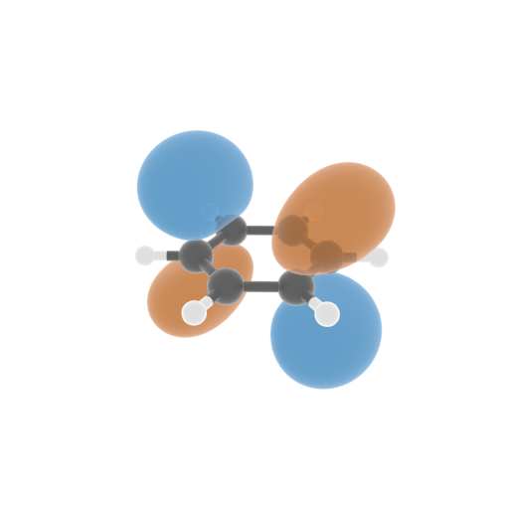
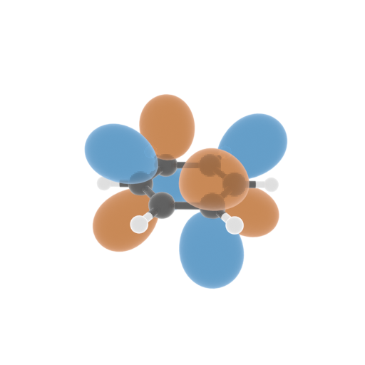
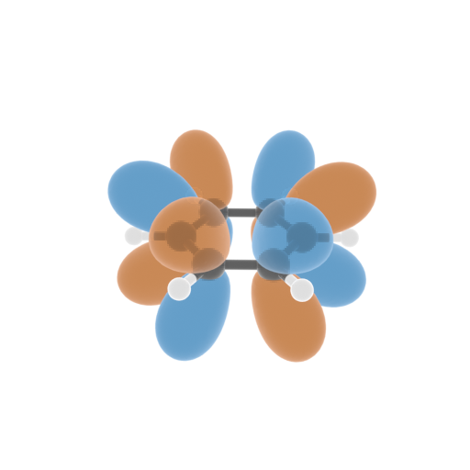

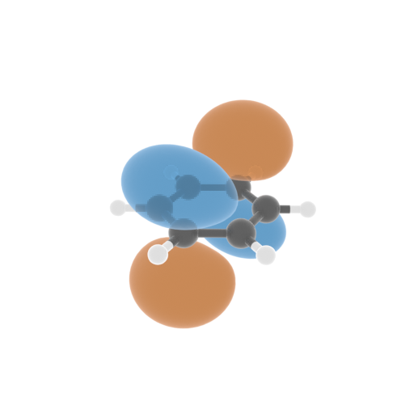
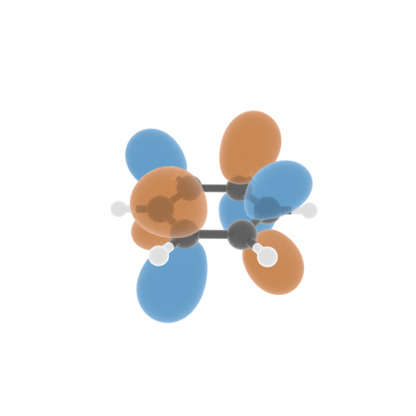
Notes:
Show what the electron clouds would look like from this purely geometrical treatment while being clear that energy optimization would give the “true” orbitals.

Slide 25




Notes:
Acknowledgementssss

